Slide 1
Using SNOMED CT Relationships for Data Exploration and Discovery in Rare Diseases - An Interactive Data Visualization Tool
Tom Balmat
Duke University, Durham, NC
Rachel L. Richesson, PhD
University of Michigan, Ann Arbor, MI
Presented at AMIA 2021 Virtual Informatics Summit
March 24, 2021
Notes:
PHASE TWO: You will be required to submit a recording of your accepted presentation as well as a PDF copy of your slides in advance of AMIA 2021 Virtual Summit as a condition of participation: 1. Recording format: you must record your presentation as either video over slides or audio over slides (i.e., Voice over PowerPoint, etc ). VERY IMPORTANT: the recording must be saved as an mp4 file and cannot exceed 4 gigabytes and 13 minutes in length. 2. In addition to the mp4 file, you will also have to submit your slides in a PDF format so that the attendees can use the handouts as a resource during your presentation. 4. Naming Convention: It is really important that you follow this naming convention for both the mp4 file and the PDF file: Session Number (i.e., S01, S02, etc.)_Presenter Last Name . 5. You must be available for live Q&A during your session on the eShow platform. 6. DEADLINE: you must submit your recording and slides by the end of the day on Wednesday, March 17, so please plan accordingly.

Slide 2
Outline
1. Recording format: you must record your presentation as either video over slides or audio over slides (i.e., Voice over PowerPoint, etc ). VERY IMPORTANT: the recording must be saved as an mp4 file and cannot exceed 4 gigabytes and 13 minutes in length. 2. In addition to the mp4 file, you will also have to submit your slides in a PDF format so that the attendees can use the handouts as a resource during your presentation. DEADLINE: you must submit your recording and slides by the end of the day on Wednesday, March 17.
SNOMED CT Background
Structure
Value
Uses in Analytics (previous work)
UCD dataset and analytic needs/goals
Data Viz tool – design
Demo Application (VIDEO)
UCDS translational science “story”
Implications and Next Steps
Live: Q&A
Rachel (will keep to 5 minutes and 5-6 slides)
Tom – 5- minutes?
Rachel (3 minutes)

Slide 3
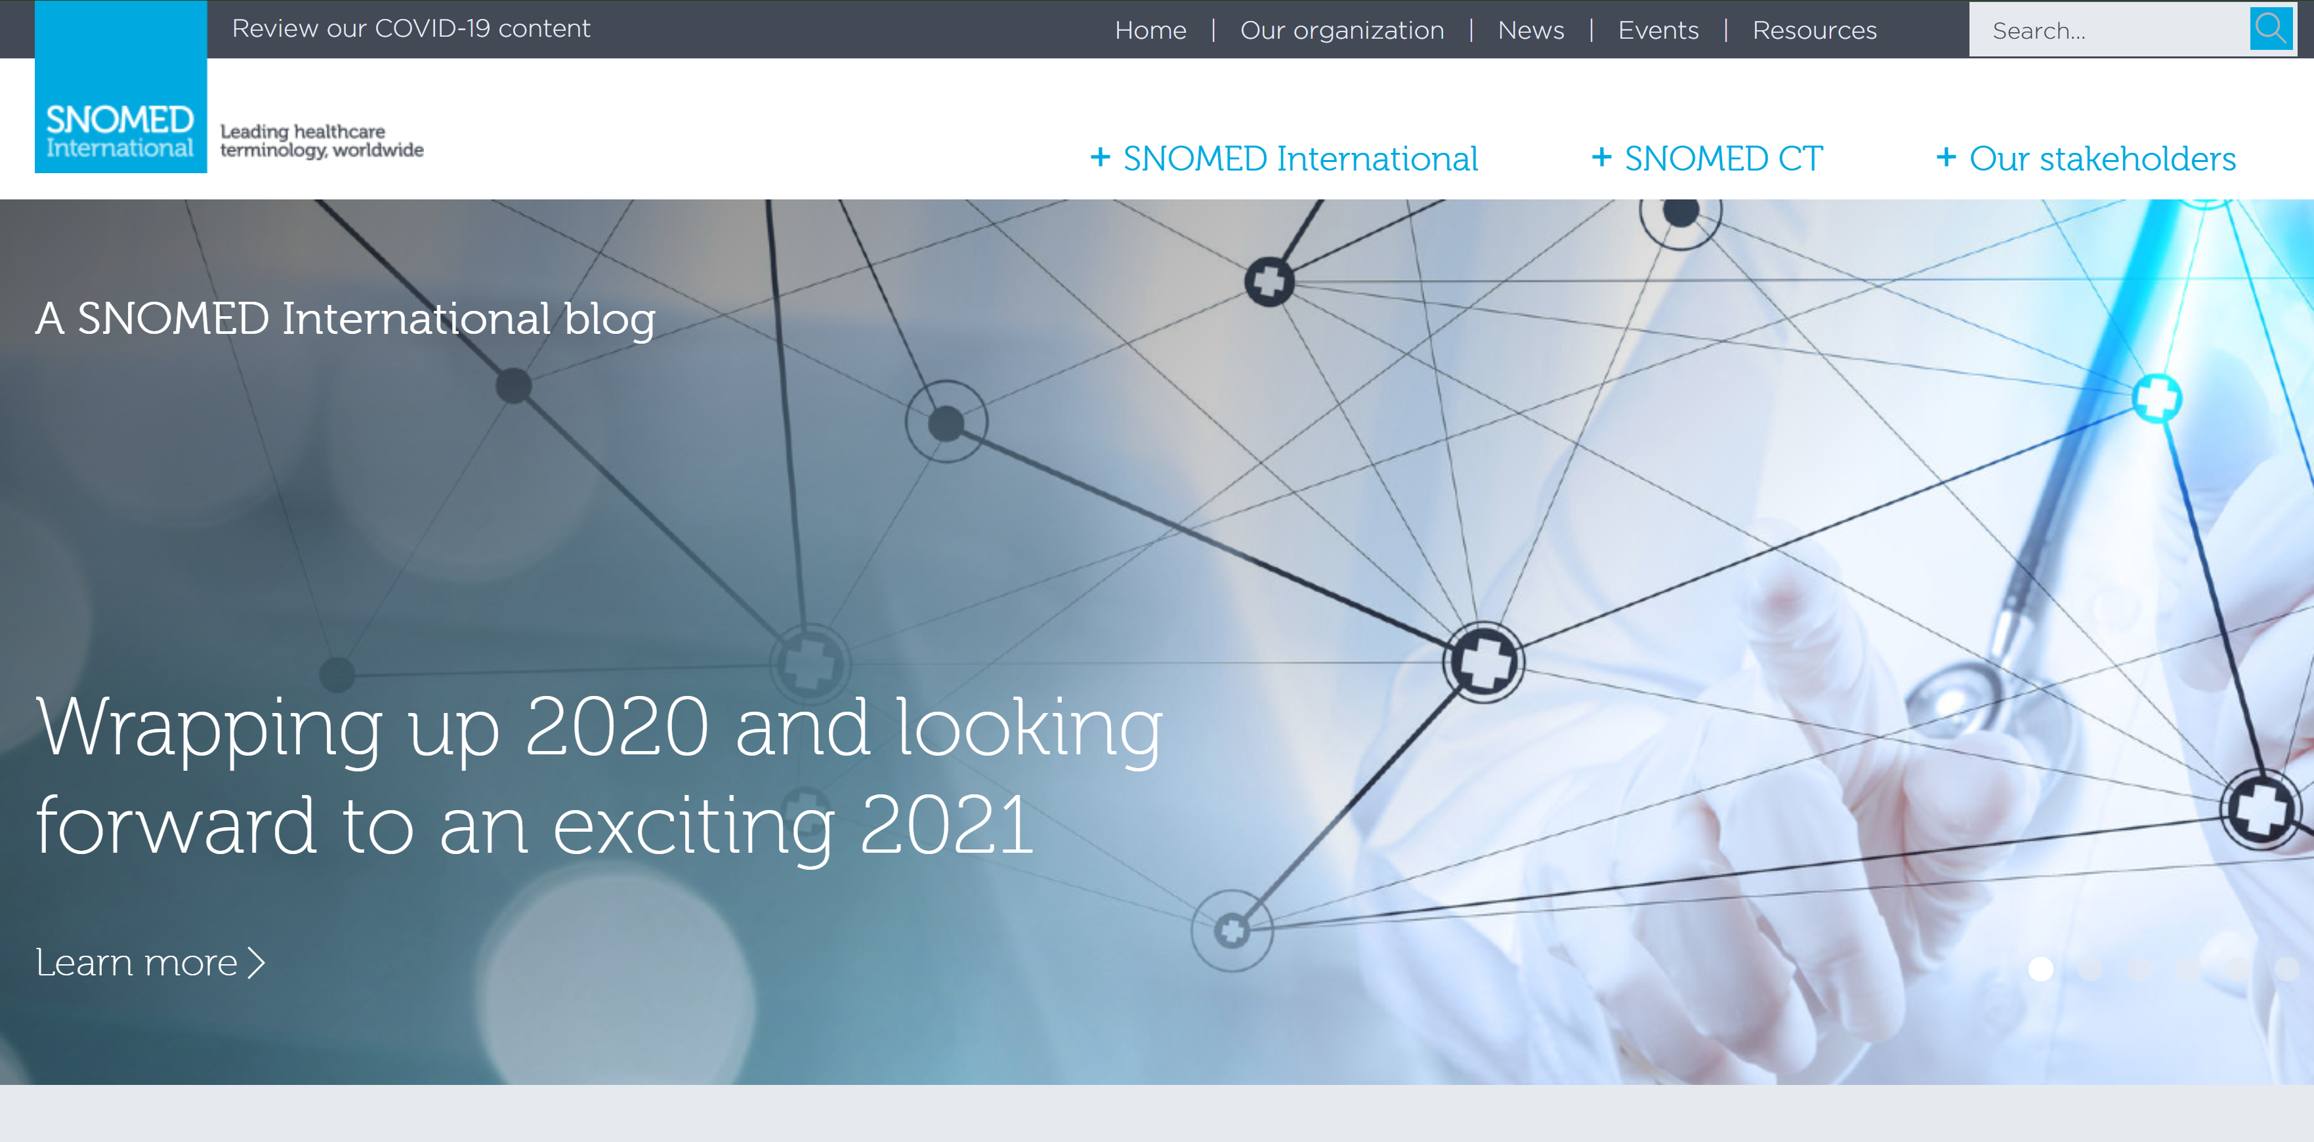
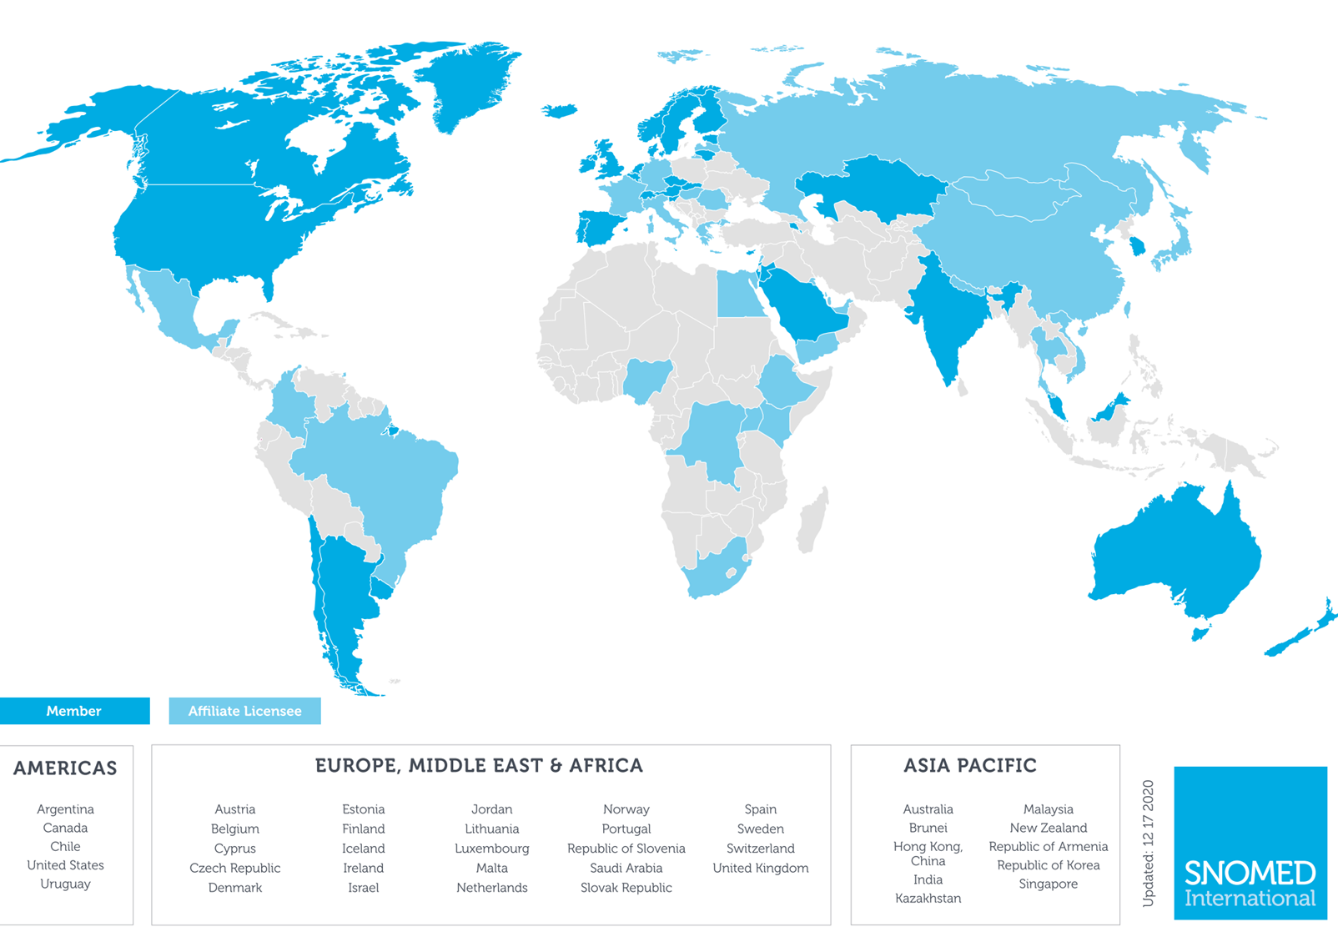
https://www.snomed.org/
Notes:
SNOMED Clinical Terms® (SNOMED CT®) is a healthcare terminology owned and maintained by the International Health Terminology Standards Development Organisation. The IHTSDO is also known as SNOMED SDO®.
Membership is open to all countries who are interested in using SNOMED CT® and working towards the goals and purpose of the Association.
Nations themselves are not members. Members are an organization which is endorsed by the Government to represent that nation. All prospective Members of the IHTSDO® must meet certain criteria (refer Clause 4.3.2 of the Articles) in order to join the Association.
Current members:
Australia
Canada (English)
Denmark
Lithuania
The Netherlands
New Zealand
Sweden
United Kingdom
United States

Slide 4
SNOMED CT Hierarchies
Clinical Finding
Physical Object
Procedure
Physical Force
Situation with explicit
context
Events
Observable Entity
Social Context
Body Structure
Staging and Scales
Linkage Concept
Organism
Qualifier Value
Substance
Environment and
geographical Location
Pharmaceutical/
Biologic Product
Special Concept
Specimen
Record Artifact
Most relevant to U.S.

Slide 5
Basic elements of SNOMED CT
Concepts
Descriptions
Hierarchies
Relationships
IS-A relationships
Attribute relationships
Concept definitions
SNOMED CT tables
Distributed in the form of text files
“Core” tables: Concepts, Descriptions, Relationships
Subsets
Mapping
History
Notes:
“Concept-based” → Each concept represents a unit of meaning
Each concept has one or more human language terms that can be used to describe the concept → DESCRIPTIONS
Relationships that link concepts; A relationship is an association between two concepts
Every concept has inter-relationships with other concepts that provide logical “computer readable” definitions
Two types of relationships:
Is_a relationships: Relationships that link concepts within a hierarchy
Attribute relationships (roles): Allow links between concepts across hierarchies
A terminology model specifies:
How to link codes to terms
How to represent meaning of codes using attributes and relationships
Constraints on permissible relationships
“Formal” definitions allow for more sophisticated queries and analysis

Slide 6
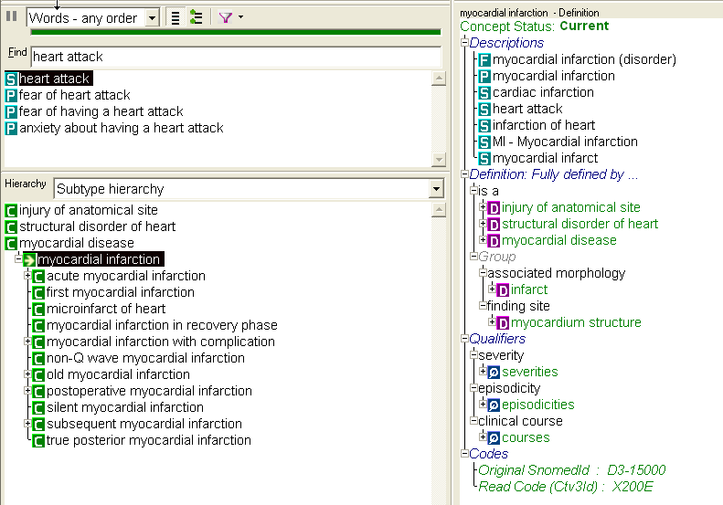
Descriptions and Definitions
FSN
Preferred
Synonyms
Notes:
Descriptions are human readable terms that name a concept
Each concept has one
Fully Specified Name (FSN) [unambiguous]
Preferred Term (display term)
Many concepts have
One or more synonyms
Each description has a DescriptionID

Slide 7
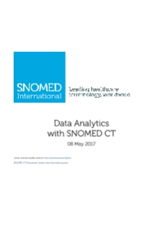
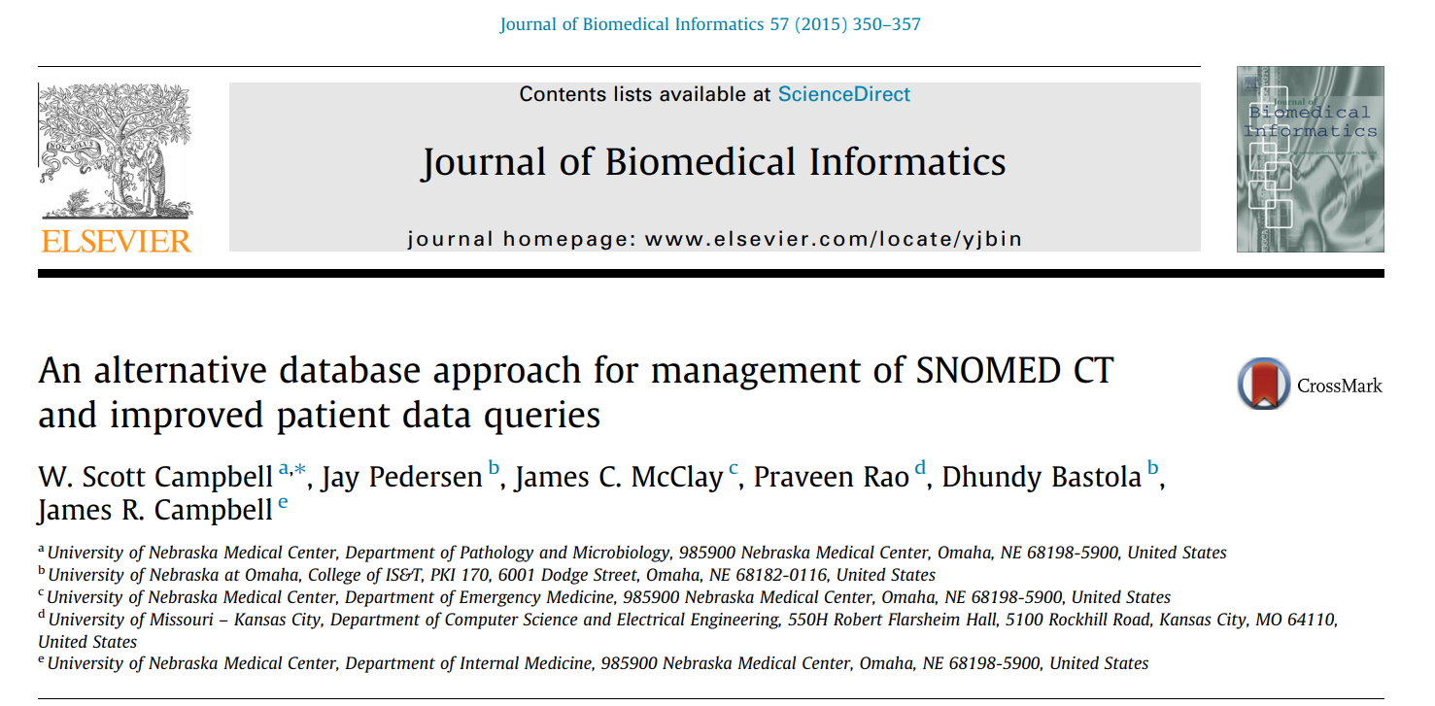
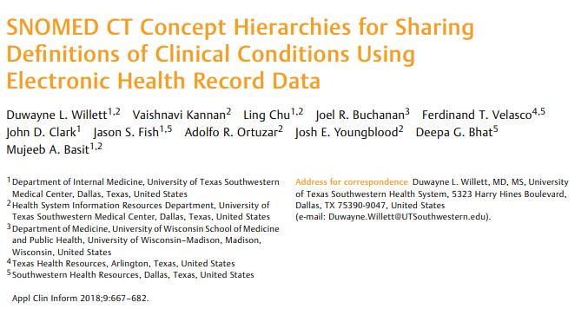
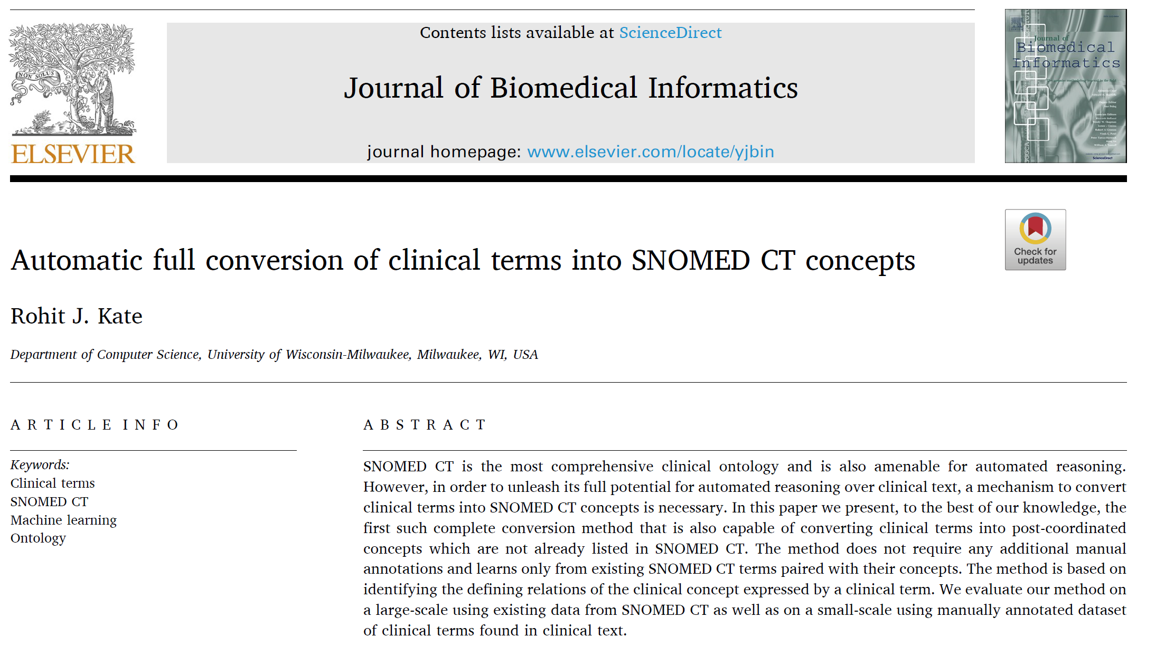
SNOMED CT in Analytics
Very limited
Query-based, “top down”
Use of relationships and inference generally for maintenance and QI
GOALS:
Can we leverage SNOMED CT relationships for data-driven analyses?
Can we use it for discovery?
Could this bridge research and clinical data sets?
2015
2018
2020
Notes:
Uses in Analytics (previous work) --verbal – 2 JBI papers (Campbell, Graph database angle, Also the new one Rohit …)
Top down ; query based; Explorations of inference, etc used mostly for terminology maintenance and improvement

Slide 8
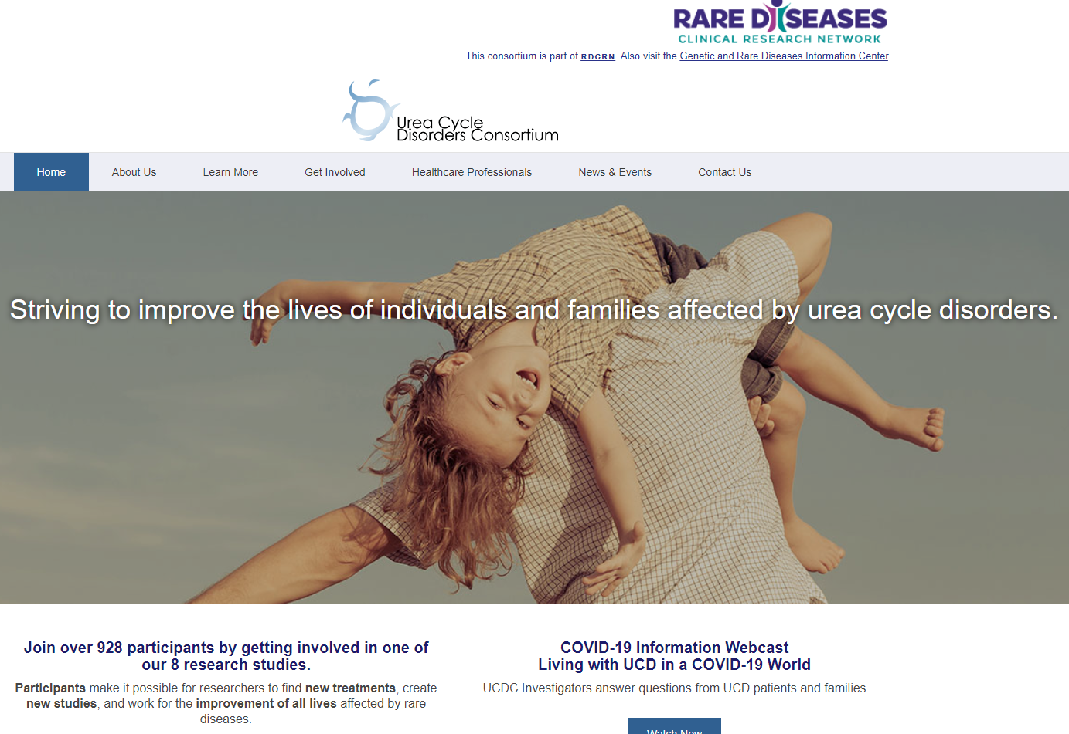
UCD Natural History Study:
733 Patients
10 Years
Researchers coded all MH and PE findings in SNOMED CT.
27,536 Records
5,320 Different SCT Codes
6,456 Records cannot be mapped to ICD10
Even after refinement:
11,775 SCT Codes from Dataset and Relationships
20,383 Relationship from SCT Codes
1,829 ICD10 Codes from SCT Codes
Notes:
Data source. The NIH-funded UCD natural history study includes data on over 800 participants, each with a confirmed molecular diagnosis of one of 8 different UCD subtypes followed over 12 years.¹ Data from UCD study used in our data visualization include patient identifier (anonymized), type of UCD diagnosis, visit date, structured information on hyperammonemic (HA) events (markers of disease exacerbation that are the hallmark of UCD), clinical observations from biannual physical exam and research visits. Medical history and physical exam observations were coded in SNOMED CT by research staff at each study visit, as described in (²). We imported the UCD study data into a Neo4J graph database along with the semantic relationships (i.e. the “knowledge base”) of SNOMED CT, building on the work of Campbell et al.³ We used their information model to link study participants with multiple research visits, each with multiple observations linked to SNOMED CT codes.

Slide 9
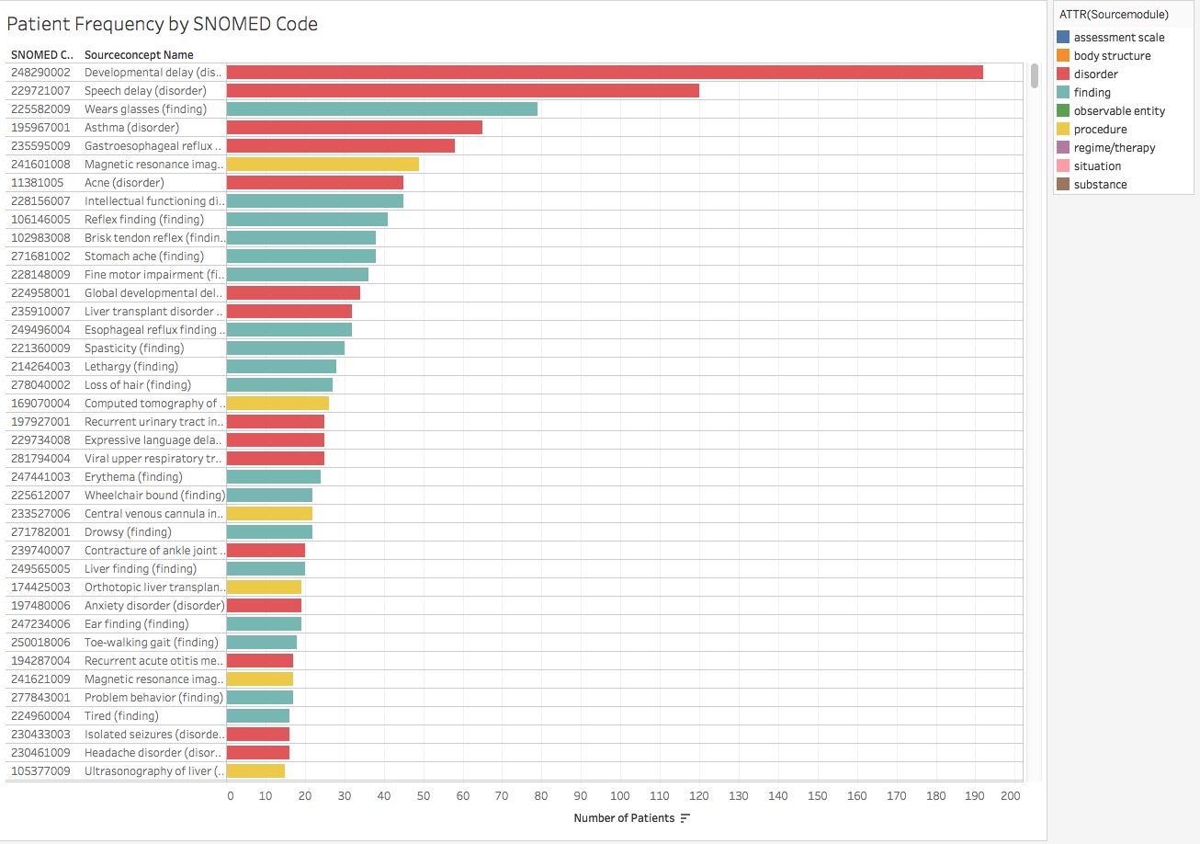

Slide 10
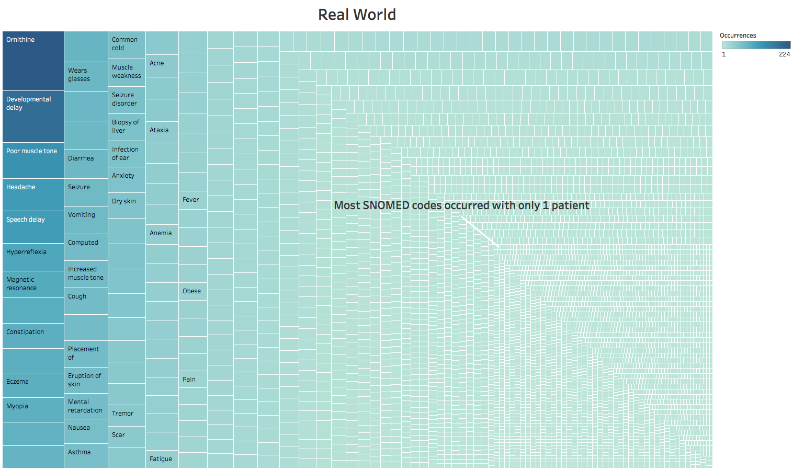

Slide 11
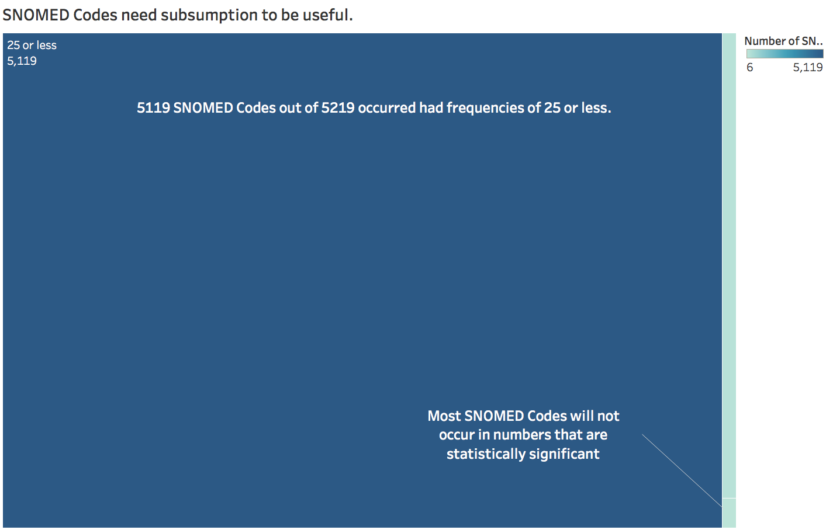

Slide 12
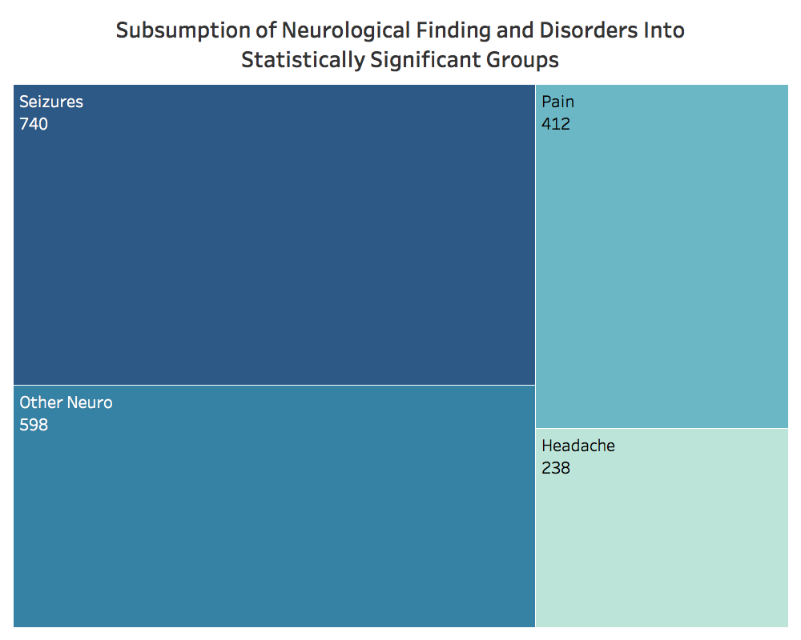

Slide 13
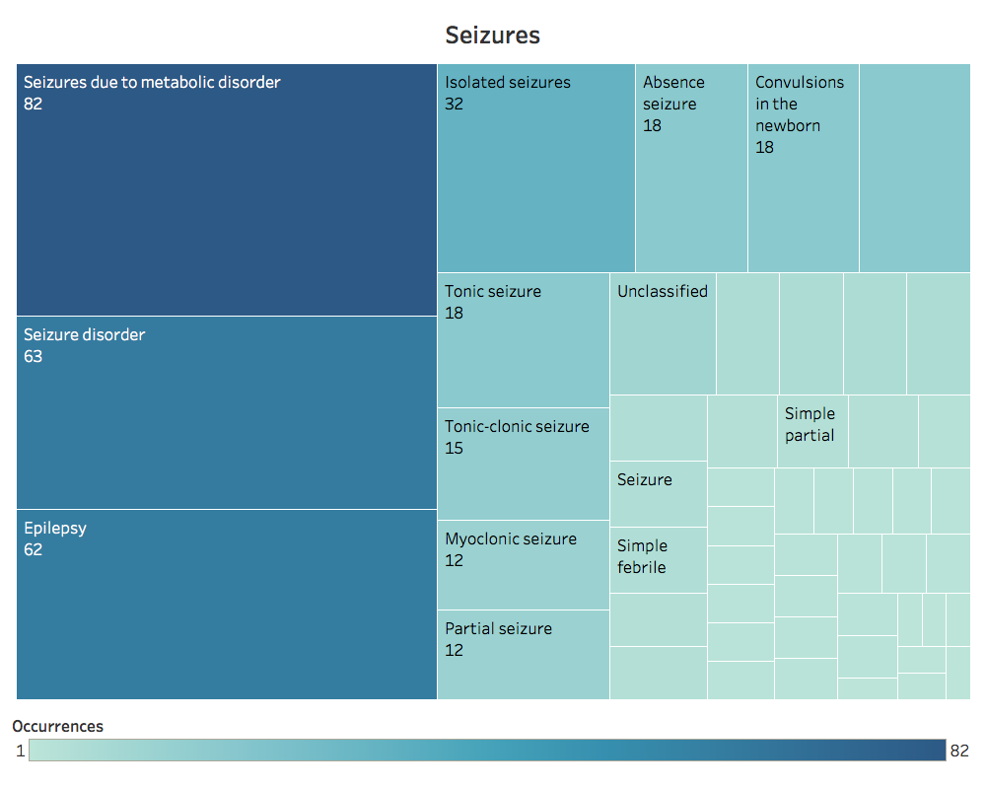

Slide 14
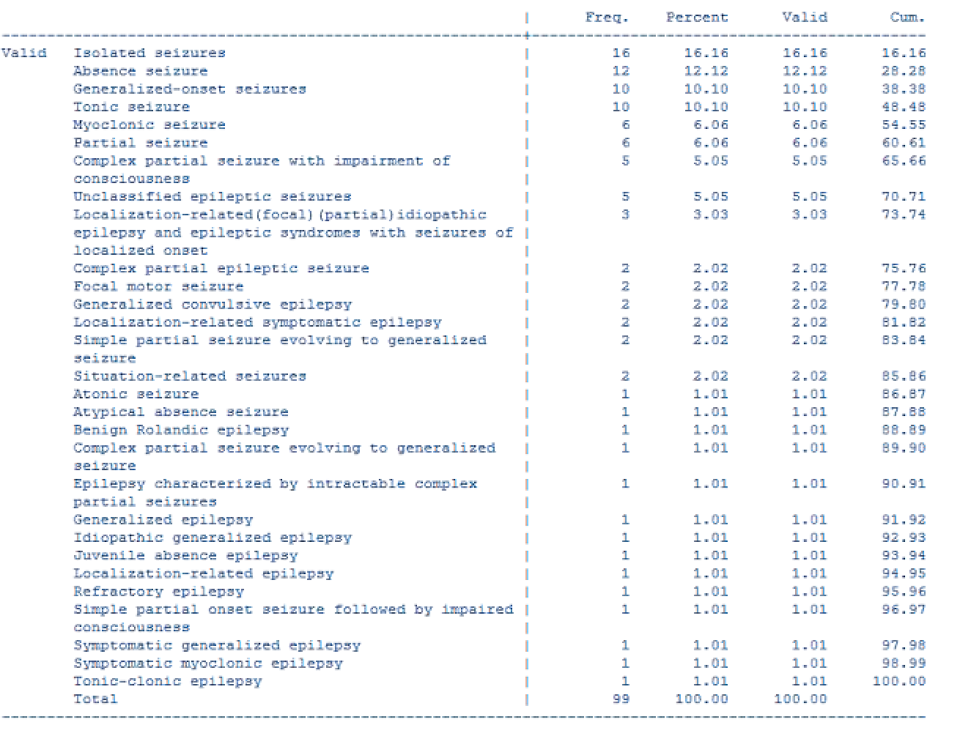

Slide 15
Notes:
Highlights
•A graph database approach employing SNOMED CT as the semantic core of a patient data warehouse.
•SNOMED CT data queries demonstrating negation and disjunction using a graph database approach.
•Using multiple controlled medical terminologies without external terminology services.
Semantic inferences enable data queries to identify data elements beyond those that are specifically enumerated in the query to also include those data elements that are logically linked to the stated query elements. Therefore, clinically important queries can be performed that utilize this logic to identify patient populations of interest for purposes of research, quality assurance, or population management.
To perform queries that leverage the conceptual inferences contain within SNOMED CT, access to the full logical model, or some representation thereof, is necessary. When SNOMED CT, or other polyhierarchical ontologies, are deployed within the context of RDBMS and OODBMS, the logical model is often instantiated in the form of transitive closure (TC) tables. A TC table represents all subsumptive relationships within a concept model in a table containing all ancestor–descendant concept pairs [9] and enable rapid queries of subsumption (see Table 1). TC tables require extensive recursive calculations when created using RDBMS or OODBMS frameworks [5], and are therefore, typically pre-calculated and incorporated into the database versus calculating at run-time. (Note: The TC table for SNOMED CT exceeds 5 million rows.)

Slide 16
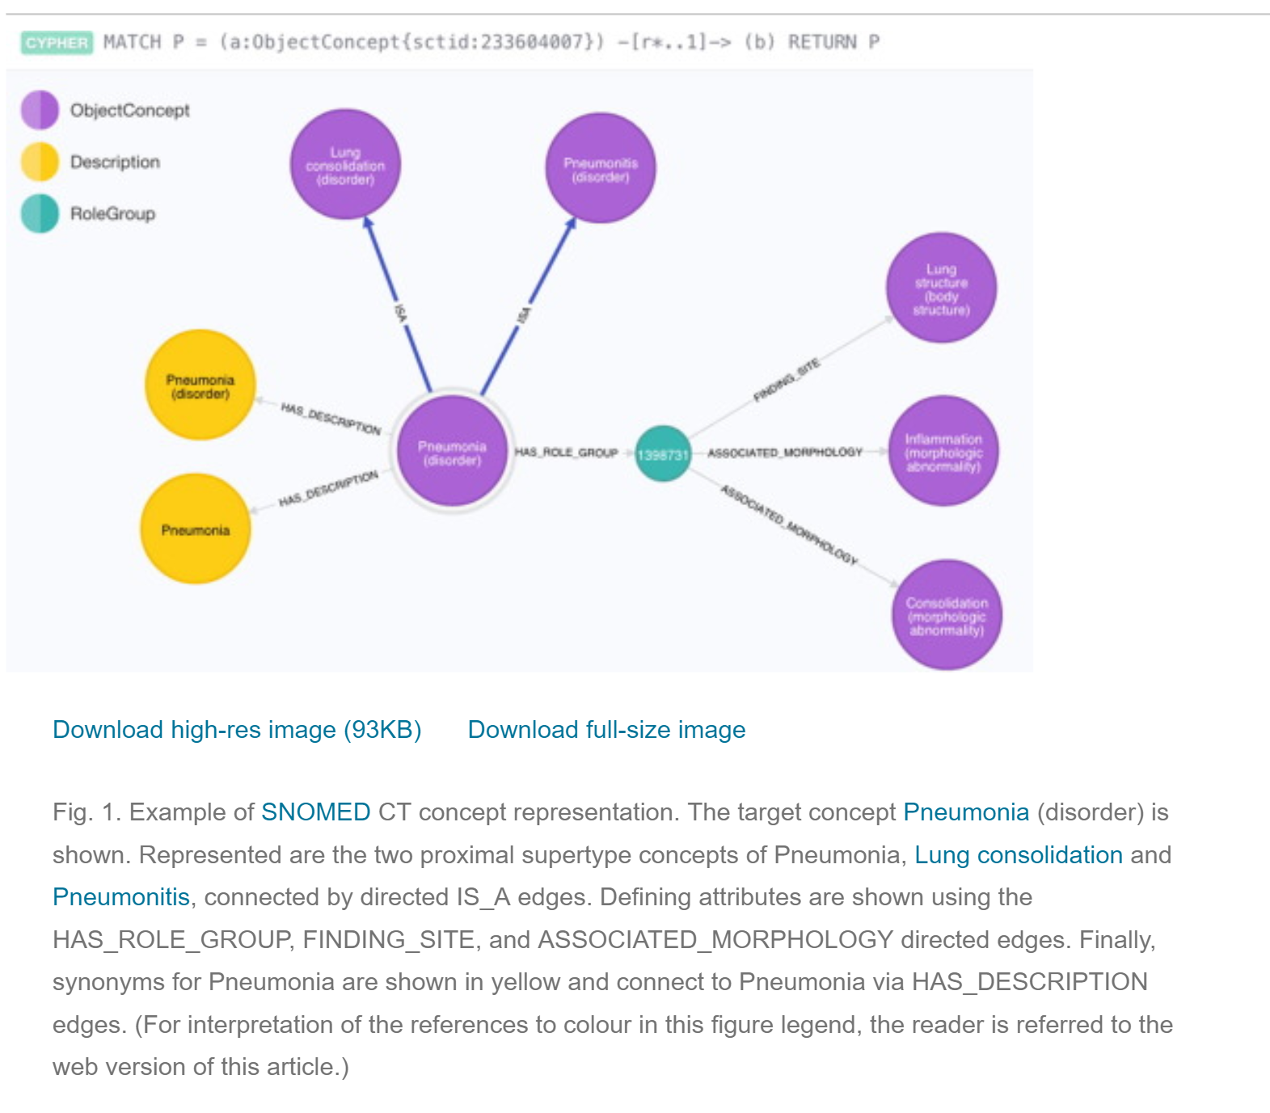
Notes:
Synergy between SCT and gDB that you do not find in other database strucutres. SQL you can do, but need the transitive closure table. More natural bridge between SCT and gDB. Espectially for queries of long length.

Slide 17
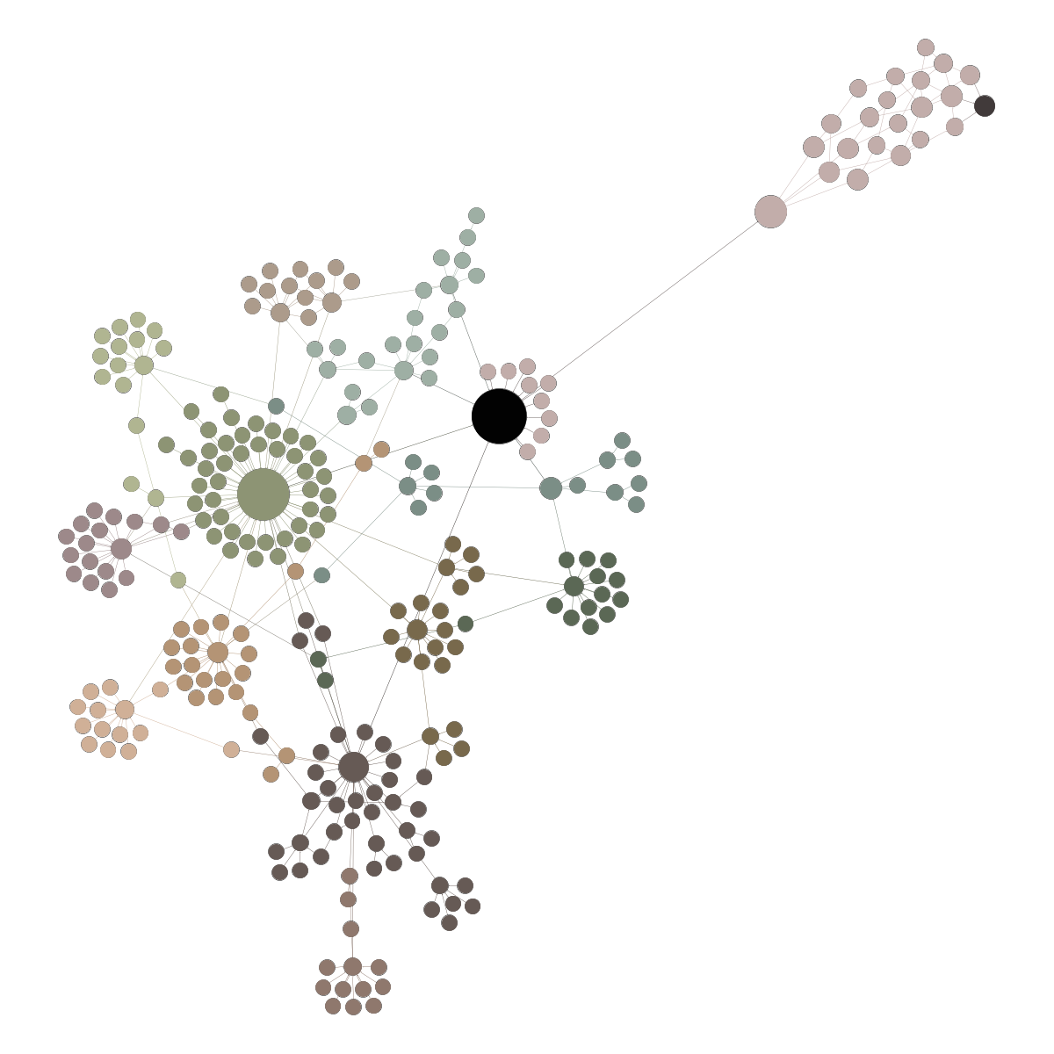
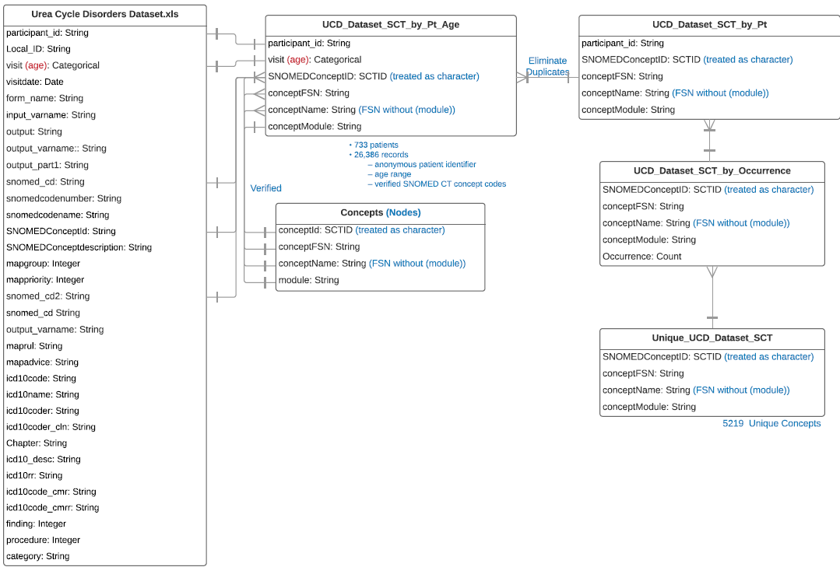
Data Model
Notes:
https://users.cs.duke.edu/~emonson/SNOMED/OtherDX_sigmaJS/#2280492

Slide 18
Motivation: Unanswered questions around mechanism of Urea Cycle Disorders (UCD)
Rachel can give this background so that the demo can show the tool and some queries for all UCD and then ALD in particular.
UCD have some issue with the Urea Cycle, which results in a failure to metabolize urea resulting in its accumulation of ammonia, a toxic metabolite, in the body.
8 UCD subtypes affecting different part of urea cycle
Some of the neurological phenotypes seen in UCD is because of ammonia in the body. Ammonia is a general neurotoxin and responsible for many different neurological symptoms.
Some specific UCD disorders (ALD, ASD, ARG) are expressed in multiple tissues outside liver. These disorders then should present symptoms even though they do not have toxic anemia (hyperammonia).
Researchers wanted to explore phenotype data (from the natural history study and our Neo4J database) to explore / confirm hypothesis related to different phenotypes (i.e., clinical findings) in different disease type and severity.
We needed a tool to do this interactively, outside of Neo4J.

Slide 19
Outline
1. Recording format: you must record your presentation as either video over slides or audio over slides (i.e., Voice over PowerPoint, etc ). VERY IMPORTANT: the recording must be saved as an mp4 file and cannot exceed 4 gigabytes and 13 minutes in length. 2. In addition to the mp4 file, you will also have to submit your slides in a PDF format so that the attendees can use the handouts as a resource during your presentation. DEADLINE: you must submit your recording and slides by the end of the day on Wednesday, March 17.
SNOMED CT Background
Structure
Value
Uses in Analytics (previous work)
UCD dataset and analytic needs/goals
Data Viz tool – design
Demo Application (VIDEO)
UCDS translational science “story”
Implications and Next Steps
Live: Q&A
Rachel (will keep to 5 minutes and 5-6 slides)
Tom – 5- minutes?
Rachel (3 minutes)

Slide 20
Tool Architecture
Tom – This can be part of the video or I can speak to it as part of my intro. Add any other technical details you want to the slide.
Data stored in Neo4J graph database stored on Duke Research Toolkits, a self-service portal for researchers and developers create to project-based virtual machines with storage and to the Duke Compute Cluster (DCC).
Interactive query tool developed in R.
Shiny package provides functions for developing web pages for user interaction, while making available the entire R suite for back-end computation.
RNeo4j provides an interface between R and a Neo4j database.
queries resulting from user-specified inquiries are executed as a Cypher query against the graph database.
visNetwork package provides functions to generate nodes and connecting edges from queried, tabular data.

Slide 21
DEMO – user experience (Tom’s VIDEO to walk through the following steps)
To use the visualization tool, a researcher selects SNOMED CT concepts from a hierarchical list patterned by the SNOMED CT browser, and additional covariates (UCD subtype, history of HA events, sex, age) to be represented as nodes in the graph.
The R script queries the UCD data in the Neo4j graph database and uses it to construct node and edge descriptor tables.
The descriptor tables are processed by visNetwork to produce a graph presented in a sub-window of the viewer’s web page.
The user reviews the graph with various roll-over labels, zooming methods, and graph reformatting operations (bipartite, tripartite, radial edge bundled). Node and edge sizes, weights, and roll-over labels indicate numbers of distinct associated participants.
Notes:
The tool was designed and developed by a senior data scientist (TB) who interacted with data and terminology experts for initial requirements and clinical UCD experts for iterative development. The tool was developed in R using the Shiny, RNeo4j, and visNetwork packages. Shiny provides functions for developing web pages for user interaction, while making available the entire R suite for back-end computation. RNeo4j provides an interface between R and a Neo4j database, so that queries resulting from user-specified inquiries are executed as a Cypher query against the graph database. visNetwork provides functions to generate nodes and connecting edges from queried, tabular data. In the next section we describe the architecture of the tool and some interesting challenges that we encountered.
Results
To use the visualization tool, a researcher selects SNOMED CT concepts from a hierarchical list patterned by the SNOMED CT browser (5), and additional covariates (UCD subtype, history of HA events, sex, age) to be represented as nodes in the graph. The R script queries the UCD data in the Neo4j graph database and uses it to construct node and edge descriptor tables. The descriptor tables are processed by visNetwork to produce a graph presented in a sub-window of the viewer’s web page. The user reviews the graph with various roll-over labels, zooming methods, and graph reformatting operations (bipartite, tripartite, radial edge bundled). Node and edge sizes, weights, and roll-over labels indicate numbers of distinct associated participants.

Slide 22
Demo – application in action; describe iterative collaborative data exploration
VIDEO – 5-7 minutes
Notes:
(The urea cycle is a cycle of biochemical reactions that produces urea (NH2)2CO from ammonia (NH3). The urea cycle converts highly toxic ammonia to urea for excretion.) Some of the neurological phenotypes seen in UCD is because of ammonia in the body. Ammonia is a general neurotoxin and responsible for many different neurological symptoms. Some specific UCD disorders (ALD, ASD, ARG) are expressed in multiple tissues outside liver. Even though they do not have toxic anemia (hyper ammonia ) .. The fact that ALD have no HA events but have resting and intentional tremors… this is a great visualization. Help us decide which of these neurological phenotypes are due to hyperammonemia (as a result of UCD and impacting the brain) versus a loss of other enzymatic function due to the specific disease/failure of the urea cycle metabolism. In other words, this visualization helps us understand that some patients are showing neurological symptoms (e.g., tremor) not because of accumulated ammonia neurotoxin (as a sequalae of UCD) but because of loss of specific enzymes (due to the UCD defect) within the neurons. Specifically, the visualization shows that patients with ALD with no hyperammonemic events have resting tremors, which is interesting and unexpected. Also, if you look at resting tremors, there seem to be more people without HA events than with…. Confirms a hypothesis/line of investigation that his research team is currently exploring, but also gives us insight into the mechanics of disease for different UCD subtypes, and potentially in the future, targets for intervention.
“If I were to look at this as researcher, I would want to know if some of the resting tremors that occur because of loss of ASL with in the neurons, which may be unrelated to the hyperammonemia, and such things that we have done in the past have led to major discoveries for role of these proteins or what they make in the cell outside of their conventional roles in metabolizing.” (27.09 minutes into the July 10 recording)

Slide 23
TOM – pick any queries that make sense to you.
Your video can have audio (preferred) or can just be video and I can add audio on top. In either case, I can provide the set-up (background) and the conclusions.
The next 2 slides are screen shots that I have in the paper (I scraped them from our Zoom calls); you do not have to be compelled to use them. I thought it would be interesting to do one query that shows all the different UCD sub-types and a SNOMED code. Then we can add the HA events / no HA events variable. (Hovering over the nodes and edges to show the counts.)
Then we could focus in on ALD as one type of UCD. And show the ALD + no-HA + intentional tremors node with the talking point.
A final talking point could be the fact that the edge thickness can be difficult to interpret when there are fewer observations.
“We found that the size connected vertices must be considered when assessing significance of relative relationships. For instance, due to its heavier connecting edge, the relationship of proximal-UCD disorders to Attention Deficit Hyperactivity Disorder appeared more significant than that to Mood Disorder in our visualization. However, the heavier edge was explained by a greater number of observations in the first relationship than in the second, when in fact, the proportions of different UCD subtypes for each SNOMED concept were similar. “

Slide 24
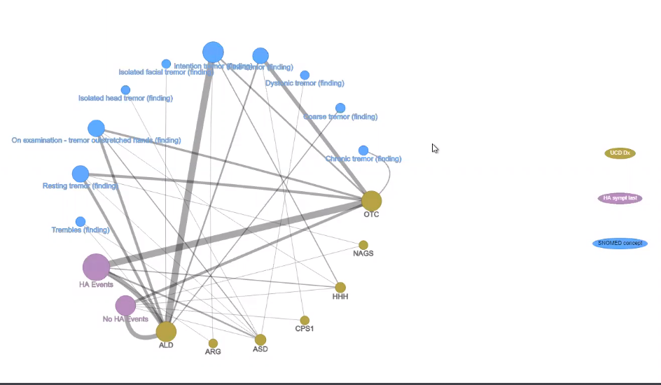

Slide 25
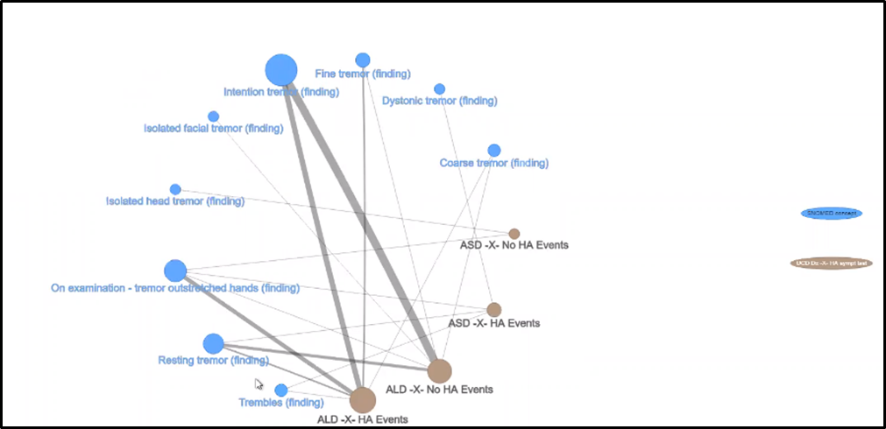
Talking point:
“The fact that ALD have no HA events but have resting and intentional tremors… this is a great visualization. Help us decide which of these neurological phenotypes are due to hyperammonemia (as a result of UCD and impacting the brain) versus a loss of other enzymatic function due to the specific disease/failure of the urea cycle metabolism.” (Sandesh quote)

Slide 26
CONCLUSIONS - can be part of your video or I can cover in my section after the demonstration.
“The fact that ALD have no HA events but have resting and intentional tremors… this is a great visualization. Help us decide which of these neurological phenotypes are due to hyperammonemia (as a result of UCD and impacting the brain) versus a loss of other enzymatic function due to the specific disease/failure of the urea cycle metabolism.”
In other words, this visualization helps us understand that some patients are showing neurological symptoms (e.g., tremor) - not because of accumulated ammonia neurotoxin (as a sequalae of UCD) - but because of loss of specific enzymes (due to the UCD defect) within the neurons (i.,e., patients with ALD + tremors and NO HA Events)
Specifically, the visualization shows that patients with ALD with no hyperammonemic events have resting tremors, which is interesting and unexpected. Also, if you look at resting tremors, there seem to be more people without HA events than with them.
Confirms a hypothesis/line of investigation that his research team is currently exploring, but also gives us insight into the mechanics of disease for different UCD subtypes, and potentially in the future, targets for intervention.

Slide 27
Challenges
Lots of complex data makes visualizations difficult to design and present
Selecting from multiple pathways in SNOMED CT and active versus inactive SNOMED concepts
determining the correct ‘level’ of semantic precision (i.e. which SNOMED concept) is meaningful in terms of addressing a translational research problem.
Exploratory questions by definition are difficult to address in a generalizable way

Slide 28
Conclusions/Implications and Next Steps
Tool requires multi-disciplinary team of experts (disease, data, technical, and SNOMED CT) to use.
GDB and SNOMED have application to many disease areas and data sets.
Configuration and features will vary by disease and data set – not a fully multi-purpose (“one size fits all”) tool.
This tool can be a template for data-driven knowledge discovery in other disease areas; variables will be different and tool will need to be customized.
NEXT Steps:
Developing better interaction with database for efficiency
~Self Service via server access to data experts on team
Application in other areas
Notes:
Data base rewrite has some big impediments. Especially with large data sets. It is inefficient

Slide 29
Acknowledgements
We are grateful to the following for their significant contributions to this work: Bob McCarter, Rima Izem, Marcia Bowen, W. Scott Campbell, Jay Petersen, Eric Monson, James Moody, Prajwal Viendra, Sigfried Gold, and Sandesh C S Nagamani, MD.
This work was supported in part by the UCD Consortium and the Duke University Office of Research Computing.
The UCD Consortium (U54HD061221) is a part of the NIH Rare Disease Clinical Research Network, supported through collaboration between the Office of Rare Diseases Research, the National Center for Advancing Translational Science (NCATS), and the Eunice Kennedy Shriver National Institute of Child Health and Human Development (NICHD).

Slide 30
EXTRA SLIDES IF NEEDED

Slide 31
Timeline and Milestones
UCD NH study enrollment begins
UCD NH study enrolls last subject and continues data collection and analysis…
Graph database – application and discussions w Univ of Nebraska (W.S. Campbell and Petersen) ; Duke support team Eric Monson
R-Shiny app for data exploration
(Tom Balmat, Duke)
Deep domain expert, S. Nagamini, MD with joins discussions
RDCRN – SNOMED browsers
2005
2006
… 2014 ….
2016
2019
2020
2021
R. McCarter / R. Richesson discussions about SNOMED
Data explorations w/ graph database
Data explorations w/ data from gDB using R-Shiny App
Marci Bowen, MSN – data cleaning, coding
MB – graph database; social network analysis
Explore specific line of inquiry with expert; evolve “translational science” story of this exploration
Submit publication and define future research

Slide 32
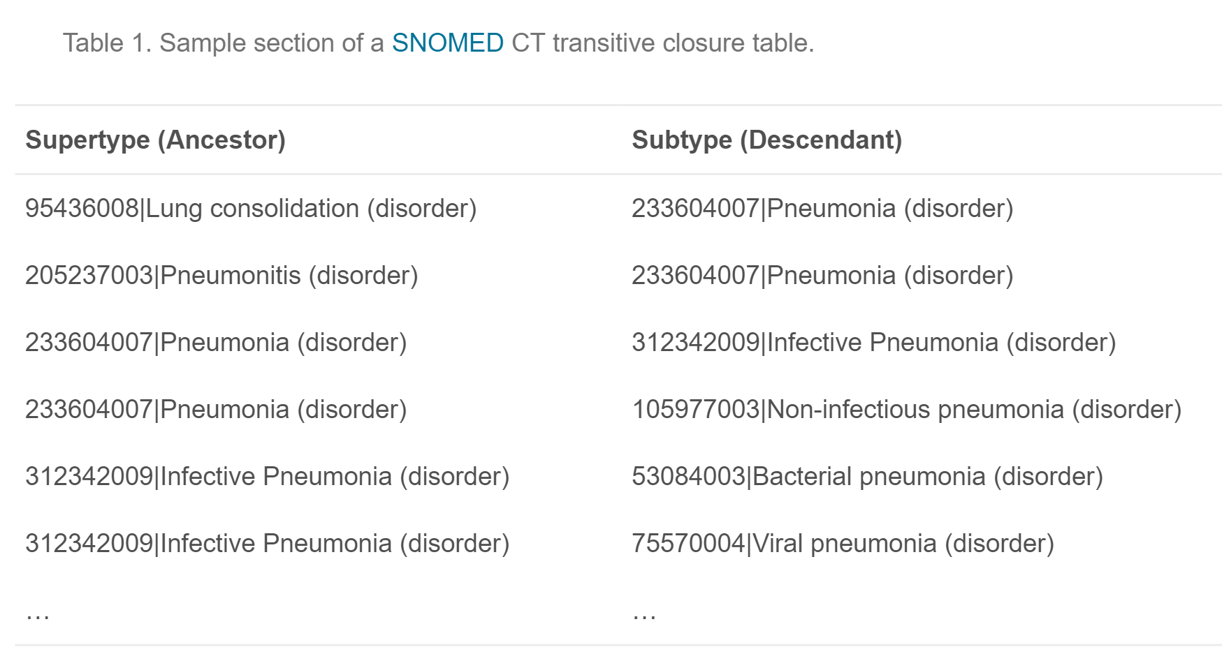
Notes:
The TC approach works well for queries of subsumption, such as finding all patients with diagnoses of any form of diabetes or all patients who have had some form of operative procedure on the knee. However, queries beyond subsumption including those of negation and disjunction are of clinical interest. For example, find all patients with pneumonia caused by streptococcus or staphylococcus (disjunction) but not klebsiella (negation), or identify all patients assessed for BRCA1 and/or BRCA2 gene mutations (disjunction) who have developed cancer without metastases (negation). These types of queries cannot be performed using the ISA (subsumptive) hierarchy exclusively and require more robust representations of the SNOMED CT concept model within EHR and clinical data repositories [10–12].

